Slide 1
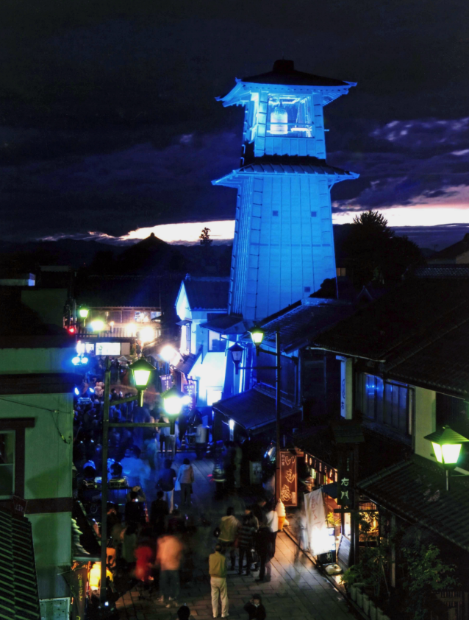

Clinical implications of insulin resistance in Pre-diabetic stage
Meet the Professor Session
The slides are available from:
http://esicon2016mtp.telemed.jp
46th Annual Conference of Endocrine Society of India
Blue Lighting at Kawagoe
Moderator: Dr. Sudip Chatterjee
Hotel Pullman New Delhi Aerocity
Asset No 02 GMR Hospitality District, New Delhi, 110037
TEL: +91 11 4608 0808
23rd October 2016 1.50 - 2.40 pm
Department of Endocrinology and Diabetes,
Saitama Medical Center, Saitama Medical University
Matsuda, Masafumi
November 14, 2009
Endocrine Society of India

Slide 2






CV
Masafumi Matsuda, MD, PhD
Research Field:
Metabolism, Endocrinology, Insulin action, Regulation in hypothalamus
Professional Experience
Resident: University of Tokyo Hospital (Hongo, Tokyo, Japan, 6/10/1982)
Resident: University of Tokyo Hospital Branch (Meziro, Tokyo, Japan, 1/10/1983)
Assistant: Internal Medicine, Yamaguchi University (Ube, Yamaguchi, Japan, 6/1/1987)
Physician: Saiki Hospital (Nagato, Yamaguchi, Japan, 6/1/1988)
Clinical Instructor: Diabetes Division, UTHSCSA (San Antonio, Texas, USA, 3/1993)
Instructor: Diabetes Division, UTHSCSA (San Antonio, Texas, USA, 9/1/1994)
Assistant Professor of Medicine: Diabetes Division, UTHSCSA (San Antonio, Texas, USA, 9/1/1996)
Medical Research Director, Clinical Research Center, Texas Diabetes Institute (1997)
Lecturer, Diabetes Division, Internal Medicine, Kawasaki Medical School, Kurashiki, Okayama, Japan (1/1/1999)
Lecturer, Endocrine and Diabetes Division, Internal Medicine, Kawasaki Medical School, Kurashiki, Okayama, Japan (4/1/2000)
Director, Diabetes and Endocrine Department, Kameda Medical Center (1/1/2006)
Professor, Department of Endocrinology and Diabetes, Saitama Medical Center, Saitama Medical University (4/1/2009-present)
Degree, Licensure and Certification
Faculty of Medicine, The University of Tokyo, Bachelor of Medicine [M.D.]
Doctor of Medical Science, Yamaguchi University [Ph.D.]
Medical Examination of National Board (Japan)
Board Certificate and Certified Physician for Residency Training in Internal Medicine, Diabetology, Endocrinology and Metabolism (Japan)
Fellow of the Japanese Society of Internal Medicine
Standard ECFMG Certificate (USA) USMLE Step 1, Step 2 and Step 3 passed (USA)
Works original articles 117 (total citation: 7220, h-index: 33 from Scopus)
Matsuda M, DeFronzo RA : Insulin sensitivity indices obtained from oral glucose tolerance testing: comparison with the euglycemic insulin clamp. Diabetes Care 22:1462-1470, 1999. (citation:>2600)
Matsuda M: Management of glucose levels in the hospital – theory and practice, Kanehara Ltd. Tokyo, Japan

Slide 3
DISCLOSURE
Name of First Author : Masafumi Matsuda, MD PhD
The authors have no financial conflicts of interest to disclose concerning the presentation.

Slide 4
Case A
56-year-old women, 151 cm, 51.6 kg: BMI 22.6 kg/m²
She visited the clinic with her daughter, because her result of health check revealed increased HbA1c and fasting PG.
BP 106/72mmHg, PR 81/min, waist 76cm
HbA1c 6.3%, PG 111mg/dL, Cr 0.53mg/dL, UA 4.6mg/dL
LDL-C 169mg/dL, TG 149mg/dL, HDL-C 69mg/dL
Urine: Protein(-), Glucose(-), Ketone(-)
<Diagnostic procedure>
Department of Endocrinology and Diabetology, Saitama Medical University International Medical Center

Slide 5
Case A
56-year-old women, 151 cm, 51.6 kg: BMI 22.6 kg/m²
She visited the clinic with her daughter, because her result of health check revealed increased HbA1c and fasting PG.
BP 106/72mmHg, PR 81/min, waist 76cm
HbA1c 6.3%, PG 111mg/dL, Cr 0.53mg/dL, UA 4.6mg/dL
LDL-C 169mg/dL, TG 149mg/dL, HDL-C 69mg/dL
Urine: Protein(-), Glucose(-), Ketone(-)
<Diagnostic procedure>
OGTT (75g oral glucose tolerance test)
Department of Endocrinology and Diabetology, Saitama Medical University International Medical Center

Slide 6
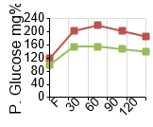
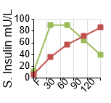
Case A
Green-Normal
Red-Patient
(powered by http://www.ogttplus.com ©2016 Dr.Suresh Shinde,MD.)
 | PG (mg/dL) | Insulin (mU/L)
0 min | 118 | 7
30 min | 202 | 36
60 min | 219 | 57
90 min | 189 | 81
120 min | 185 | 86

Slide 7
Case A
 | PG (mg/dL) | Insulin (mU/L)
0 min | 118 | 7
30 min | 202 | 36
60 min | 219 | 57
90 min | 189 | 81
120 min | 185 | 86

Slide 8
Diagnosis: impaired glucose tolerance
(increased FPG
and postprandial hyperglycemia)
Pathophysiology: decreased insulin secretion
(beta-cell damages)
What should we do to prevent further damage to pancreatic beta-cells?

Slide 9
Case A
56-year-old women, 151 cm, 51.6 kg: BMI 22.6 kg/m²
She visited the clinic with her daughter, because her result of health check revealed increased HbA1c and fasting PG.
BP 106/72mmHg, PR 81/min, waist 76cm
HbA1c 6.3%, PG 111mg/dL, Cr 0.53mg/dL, UA 4.6mg/dL
LDL-C 169mg/dL, TG 149mg/dL, HDL-C 69mg/dL
Urine: Protein(-), Glucose(-), Ketone(-)
<Therapeutic procedure>
1400 kcal/day diet, moderate exercise
?
Department of Endocrinology and Diabetology, Saitama Medical University International Medical Center

Slide 10
Case A
56-year-old women, 151 cm, 51.6 kg: BMI 22.6 kg/m²
She visited the clinic with her daughter, because her result of health check revealed increased HbA1c and fasting PG.
BP 106/72mmHg, PR 81/min, waist 76cm
HbA1c 6.3%, PG 111mg/dL, Cr 0.53mg/dL, UA 4.6mg/dL
LDL-C 169mg/dL, TG 149mg/dL, HDL-C 69mg/dL
Urine: Protein(-), Glucose(-), Ketone(-)
<Therapeutic procedure>
1400 kcal/day diet, moderate exercise
voglibose 0.2mg tid
Department of Endocrinology and Diabetology, Saitama Medical University International Medical Center

Slide 11
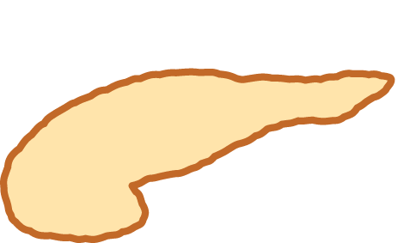
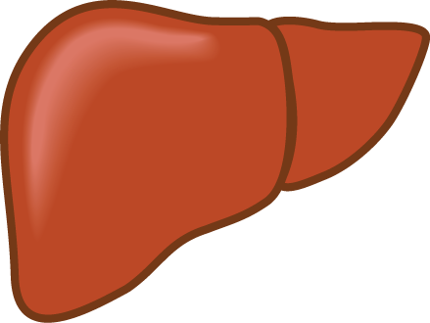

THE TRIUMVIRATE
Impaired Insulin Secretion
Hyperglycemia
Decreased
Glucose
Uptake
Increased
HGP
DeFronzo RA, Diabetes 37:667-687, 1988

Slide 12
ETIOLOGY OF T2DM
Impaired Insulin Secretion
Increased FFA
Increased
HGP
Decreased Glucose
Uptake

Slide 13
Natural History of Type 2 Diabetes Mellitus
Kendall DM, Bergenstal RM ©2003 International Diabetes Center, Minneapolis, MN.

Slide 14
Lifestyle Modification Intervention
Lifestyle intervention continues to have an effect, even after 20 years
Study |  | N | Intervention | Treatment | Risk Reduction
Da Qing^{1,2} | IGT | 577 | Lifestyle | 6 years 20 years | 34% - 69%
Finnish DPS^{3,4} | IGT | 523 | Lifestyle | 3+ years 7 years | 58%
Diabetes Prevention Program (DPP)^{5,6} | IGT | 3324 | Lifestyle | 3 years 10 years | 58% 34%
1. Diabetes Care. 1997;20:537-544. 2. Lancet. 2008;371:1783-1789.
3. N Engl J Med. 2001;344:1343-1350. 4. Lancet. 2006;368:1673-1679.
5. N Engl J Med. 2002;346:393-403. 6. Lancet. 2009;374:1677-1686.

Slide 15
Intervention Studies to Prevent T2D
Trial | publication | follow-up, year | drug | No. of new on-set of DM | No.(total) | event per 1000 person-years | control | No. of new on-set of DM | No.(total) | event per 1000 person-years
Thiazolidine
*DPP | 2005 | 0.9 | Troglitazone | 10 | 387 | 28.7 | Placebo Metformin ILS | 37 21 16 | 391 397 393 | 105.1 58.8 45.2
TRIPOD | 2002 | 2.5 | Troglitazone | 17 | 114 | 59.6 | Placebo | 37 | 122 | 121.3
PIPOD | 2006 | 3.0 | Pioglitazone | 11 | 86 | 42.6 | -
*DREAM | 2006 | 3.0 | Rosiglitazone | 306 | 2365 | 43.1 | Placebo | 686 | 2634 | 86.8
*ACTNOW | 2008 | 4.0 | Pioglitazone | 10 | 303 | 8.3 | Placebo | 45 | 299 | 37.6
*CANOE | 2010 | 3.9 | Met+Rosi | 14 | 103 | 34.9 | Placebo | 41 | 104 | 101.1
Other (α-GI, statin, fibrate, glinide)
WOSCOP | 2001 | 5.0 | Pravastation | 57 | 2999 | 3.8 | Placebo | 82 | 3975 | 5.5
*STOP- NIDDM | 2002 | 3.3 | Acarbose | 221 | 682 | 98.2 | Placebo | 285 | 686 | 125.9
BIP | 2004 | 6.2 | Bezafibrate | 66 | 156 | 68.2 | Placebo | 80 | 147 | 87.8
*VICTORY | 2009 | 4.0 | Voglibose | 50 | 897 | 13.9 | Placebo | 106 | 881 | 30.0
*NAVIGATOR | 2010 | 6.5 | Nateglinide | 1674 | 3726 | 69.1 | Placebo | 1580 | 3747 | 64.9
*: pre-specfied outcome
Matsuda M.;GEKKAN TOUNYOUBYOU;2,16-22,2010 2:16-22, 2010.

Slide 16
Prevention of Diabetes Mellitus
Trial | publication | follow-up, year | drug | No. of new on-set of DM | No.(total) | event per 1000 person-years | control | No. of new on-set of DM | No.(total) | event per 1000 person-years
antihypertensive drug
CAPPP | 1999 | 6.1 | ACEI | 337 | 5183 | 10.7 | β blocker | 380 | 5230 | 11.9
STOP-2 | 1999 | 4.0 | ACEI | 93 | 1970 | 11.8 | β blocker Diuretic CCB | 97 95 | 1960 1935 | 12.4 12.1
HOPE | 2001 | 4.5 | ACEI | 102 | 2837 | 8.0 | Placebo | 155 | 2883 | 11.9
ALLHAT | 2002 | 4.0 | ACE | 119 | 4096 | 7.3 | CCB Diuretic | 154 302 | 3954 6766 | 9.7 11.2
PEACE | 2004 | 4.8 | ACEI | 335 | 3432 | 20.3 | Placebo | 399 | 3472 | 23.9
ANBP-2 | 2005 | 4.1 | ACEI | 138 | 2800 | 12.0 | Diuretic | 200 | 2826 | 17.3
AASK | 2006 | 3.8 | ACEI | 45 | 410 | 28.9 | β blocker CCB | 70 32 | 405 202 | 45.5 41.7
*DREAM | 2006 | 3.0 | ACEI | 449 | 2623 | 57.1 | Placebo | 489 | 2646 | 61.6
LIFE | 2002 | 4.8 | ARB | 242 | 4020 | 12.5 | β blocker | 320 | 3979 | 16.8
*ALPINE | 2003 | 1.0 | ARB | 1 | 196 | 5.1 | Diuretic | 8 | 196 | 40.8
CHARM | 2003 | 3.1 | ARB | 163 | 2715 | 19.4 | Placebo | 202 | 2721 | 23.9
SCOPE | 2003 | 3.7 | ARB | 93 | 2167 | 11.6 | Placebo | 115 | 2175 | 14.3
VALUE | 2004 | 4.2 | ARB | 690 | 5087 | 32.3 | CCB | 845 | 5074 | 39.7
CASE-J | 2007 | 3.2 | ARB | 38 | 1343 | 8.8 | CCB | 59 | 1342 | 13.7
*ProFESS | 2008 | 2.5 | ARB | 125 | 7306 | 6.8 | Placebo | 151 | 7283 | 8.3
*ONTARGET | 2008 | 4.7 | ARB | 399 | 8542 | 10.0 | ACEI | 366 | 8576 | 9.2
*ONTARGET | 2008 | 4.7 | ARB +ACEI | 323 | 8502 | 8.1 | ACEI | 366 | 8576 | 9.2
*TRANSCEND | 2008 | 4.7 | ARB | 319 | 2954 | 26.4 | Placebo | 395 | 2972 | 28.8
*HIJ-CREATE | 2009 | 4.2 | ARB | 7 | 645 | 2.6 | Placebo | 18 | 624 | 6.9
*Kyoto Heart | 2009 | 3.27 | ARB+X | 58 | 1116 | 51.6 | X | 86 | 998 | 76.7
*NAVIGATOR | 2010 | 6.5 | ARB | 1532 | 3748 | 62.9 | Placebo | 1722 | 3725 | 71.1
Matsuda M.; Endocrinology＆Diabetology;26,1,35-41,2008.

Slide 17
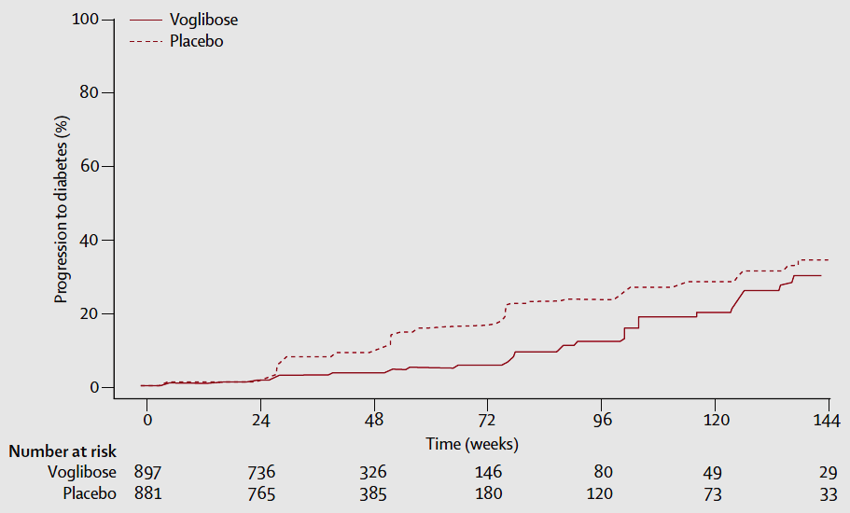
VICTORY trial
The HR was 0・595 (95% CI 0・433–0・818), showing that voglibose-treated individuals had a 40・5% lower risk of developing type 2 diabetes than did placebo-treated individuals (p=0・0014)
40.5% reduction
Effect of voglibose and placebo on the cumulative probability of individuals developing type 2 diabetes (Kaplan–Meier method)
Kawamori R, Tajima N, Iwamoto Y, Kashiwagi A, Shimamoto K, Kaku K; Voglibose Ph-3 Study Group.: Voglibose for prevention of type 2 diabetes mellitus: a randomised, double-blind trial in Japanese individuals with impaired glucose tolerance. Lancet. 2009 May 9;373(9675):1607-14.

Slide 18
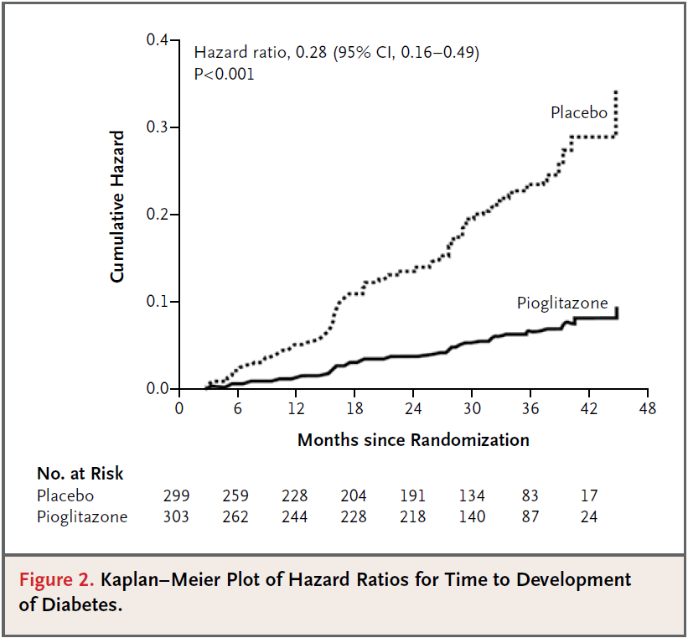
ACTNOW trial
72％reduction!
N Engl J Med 2011;364:1104-15.

Slide 19
EFFECT OF PIOGLITAZONE AND PLACEBO ON MATSUDA INDEX OF INSULIN SENSITIVITY
Placebo
Pioglitazone
10
Insulin sensitivity as measured with the Matsuda index increased more with pioglitazone than with placebo (4.31±0.24 to 7.65±0.34 vs. 4.31±0.30 to 5.23±0.31, P<0.001).
8
P<0.001
6
Matsuda Index
4
2
0
Pre
Post
Pre
Post

Slide 20
EFFECT OF PIOGLITAZONE AND PLACEBO ON INSULIN SECRETION / INSULIN RESISTANCE INDEX
Placebo
Pioglitazone
6
P<0.005
5
4
ΔI/ΔG xMatsuda (0-120)
3
2
1
0
Pre
Post
Pre
Post

Slide 21
24％reduction!
Figure 1. Primary Outcome. By 5 years, the primary outcome (fatal or nonfatal stroke or fatal or nonfatal myocardial infarction) had occurred in 175 of 1939 patients (9.0%) in the pioglitazone group and in 228 of 1937 (11.8%) in the placebo group. The inset shows the same data on an enlarged y axis. The numbers at risk were the numbers of patients who were alive without an event and still being followed at the beginning of each time point.
N Engl J Med. 2016 Apr 7;374(14):1378-9.

Slide 22
At 4 months or later (after the core lifestyle curriculum was completed), intervention participants were prescribed metformin at a dose of 500 mg twice daily if they were considered at high risk of converting to diabetes, defined as having IFG+IGT or IFG+ HbA1c$5.7% (39mmol/mol).
32％reduction!
Cumulative incidence of diabetes by study arm in the D-CLIP trial from baseline to year 3.
Weber MB, Ranjani H, Staimez LR, Anjana RM, Ali MK, Narayan KM, Mohan V.: The Stepwise Approach to Diabetes Prevention: Results From the D-CLIP Randomized Controlled Trial. Diabetes Care. 2016 Oct;39(10):1760-7.

Slide 23
Message
It may be reasonable to use drugs that reduce insulin resistance or beta-cell hyper function to prevent beta-cell damages even to subjects who may not have apparent insulin resistance.

Slide 24
Case A
one year later
57-year-old women, 151 cm, 53.1 kg: BMI 23.3 kg/m²
She visited the clinic for a routine check-up.
BP 100/68mmHg, PR 79/min
HbA1c 6.5%, PG 115mg/dL, Cr 0.59mg/dL, UA 4.4mg/dL
LDL-C 163mg/dL, TG 205mg/dL, HDL-C 69mg/dL
Urine: Protein(-), Glucose(-), Ketone(-)
<Diagnostic procedure>
OGTT (75g oral glucose tolerance test)
Department of Endocrinology and Diabetology, Saitama Medical University International Medical Center

Slide 25
Case A
one year later
A year
before
 | PG (mg/dL) | Insulin (mU/L)
0 min | 115 | 6
30 min | 164 | 28
60 min | 187 | 48
90 min | 189 | 65
120 min | 131 | 37

Slide 26
Case A
one year later
57-year-old women, 151 cm, 53.1 kg: BMI 23.3 kg/m²
She visited the clinic for a routine check-up.
BP 100/68mmHg, PR 79/min
HbA1c 6.5%, PG 115mg/dL, Cr 0.59mg/dL, UA 4.4mg/dL
LDL-C 163mg/dL, TG 205mg/dL, HDL-C 69mg/dL
Urine: Protein(-), Glucose(-), Ketone(-)
<Therapeutic procedure>
1400 kcal/day diet, moderate exercise
voglibose 0.2mg tid
?
Department of Endocrinology and Diabetology, Saitama Medical University International Medical Center

Slide 27
Case A
one year later
57-year-old women, 151 cm, 53.1 kg: BMI 23.3 kg/m²
She visited the clinic for a routine check-up.
BP 100/68mmHg, PR 79/min
HbA1c 6.5%, PG 115mg/dL, Cr 0.59mg/dL, UA 4.4mg/dL
LDL-C 163mg/dL, TG 205mg/dL, HDL-C 69mg/dL
Urine: Protein(-), Glucose(-), Ketone(-)
<Therapeutic procedure>
1400 kcal/day diet, moderate exercise
voglibose 0.2mg tid
atorvastatin 10mg qd
Department of Endocrinology and Diabetology, Saitama Medical University International Medical Center

Slide 28
Case A
two years later
58-year-old women, 151 cm, 53.0 kg: BMI 23.3 kg/m²
She visited the clinic for a routine check-up.
BP 122/53mmHg, PR 72/min
HbA1c 7.1%, PG 112mg/dL, Cr 0.50mg/dL, UA 4.8mg/dL
LDL-C 100mg/dL, TG 100mg/dL, HDL-C 76mg/dL
Urine: Protein(-), Glucose(-), Ketone(-)
<Therapeutic procedure>
1400 kcal/day diet, moderate exercise
voglibose 0.2mg tid
atorvastatin 10mg qd
Department of Endocrinology and Diabetology, Saitama Medical University International Medical Center

Slide 29
Case A
two years later
A year
before
Two years
before
 | PG (mg/dL) | Insulin (mU/L)
0 min | 112 | 7
30 min | 162 | 26
60 min | 230 | 71
90 min | 194 | 71
120 min | 160 | 69

Slide 30
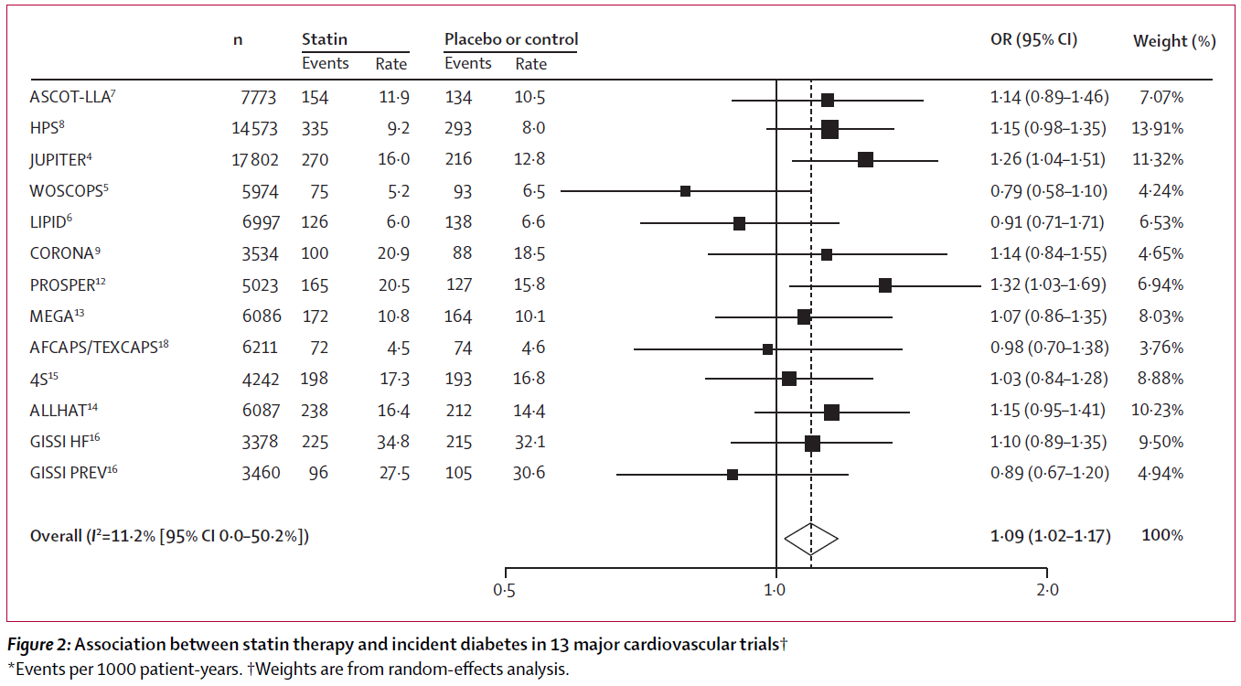
Lancet. 2010 Feb 27;375(9716):735-742.

Slide 31
Exposure to LDL-C-lowering genetic variants in or near NPC1L1 and other genes was associated with a higher risk of type 2 diabetes.
JAMA. 2016 Oct 4;316(13):1383-1391.

Slide 32
Case A
two years later
58-year-old women, 151 cm, 53.0 kg: BMI 23.3 kg/m²
She visited the clinic for a routine check-up.
BP 122/53mmHg, PR 72/min
HbA1c 7.1%, PG 112mg/dL, Cr 0.50mg/dL, UA 4.8mg/dL
LDL-C 100mg/dL, TG 100mg/dL, HDL-C 76mg/dL
Urine: Protein(-), Glucose(-), Ketone(-)
<Therapeutic procedure>
1400 kcal/day diet, moderate exercise
teneligliptin 20mg qd (we started to treat her as T2D)
atorvastatin 10mg qd
Department of Endocrinology and Diabetology, Saitama Medical University International Medical Center

Slide 33
Case B
65-year-old women, 155 cm, 75 kg: BMI 31.2 kg/m²
She was referred from a nephrologist, asking us to exclude secondary obesity from endocrine diseases.
BP 139/79mmHg, PR 54/min, waist 84cm
HbA1c 5.5%, PG 94mg/dL, Cr 1.75mg/dL, UA 4.8mg/dL
LDL-C 105mg/dL, TG 142mg/dL, HDL-C 59mg/dL
Urine: Protein(-), Glucose(-), Ketone(-)
<drugs> lafutidine (10mg) 1T qd, irbesartan (100mg) 1T qd,
fenofibrate (53.3mg) 1T 1qd
<Examination>
ACTH 9.2 pg/mL, cortisol 10.0 μg/dL
FT3 2.52 pg/mL, FT4 1.25 ng/mL, TSH 2.50 IU/mL
Department of Endocrinology and Diabetology, Saitama Medical University International Medical Center

Slide 34
Case B
 | PG (mg/dL) | Insulin (mU/L)
0 min | 93 | 10
30 min | 165 | 94
60 min | 176 | 149
90 min | 170 | 181
120 min | 145 | 192

Slide 35
Diagnosis: impaired glucose tolerance
(postprandial hyperglycemia)
Pathophysiology: slightly low insulin sensitivity
Since she had a kidney dysfunction, insulin conc. was kept to be higher.
What should we do to prevent further damage to pancreatic beta-cells?

Slide 36
Case B
65-year-old women, 155 cm, 75 kg: BMI 31.2 kg/m²
She was referred from a nephrologist, asking us to exclude secondary obesity from endocrine diseases.
BP 139/79mmHg, PR 54/min, waist 84cm
HbA1c 5.5%, PG 94mg/dL, Cr 1.75mg/dL, UA 4.8mg/dL
LDL-C 105mg/dL, TG 142mg/dL, HDL-C 59mg/dL
Urine: Protein(-), Glucose(-), Ketone(-)
<drugs> lafutidine (10mg) 1T qd, irbesartan (100mg) 1T qd,
fenofibrate (53.3mg) 1T 1qd
<Therapeutic approach>
1400 kcal/day diet, moderate exercise
?
Department of Endocrinology and Diabetology, Saitama Medical University International Medical Center

Slide 37
Case B
65-year-old women, 155 cm, 75 kg: BMI 31.2 kg/m²
She was referred from a nephrologist, asking us to exclude secondary obesity from endocrine diseases.
BP 139/79mmHg, PR 54/min, waist 84cm
HbA1c 5.5%, PG 94mg/dL, Cr 1.75mg/dL, UA 4.8mg/dL
LDL-C 105mg/dL, TG 142mg/dL, HDL-C 59mg/dL
Urine: Protein(-), Glucose(-), Ketone(-)
<drugs> lafutidine (10mg) 1T qd, irbesartan (100mg) 1T qd,
fenofibrate (53.3mg) 1T 1qd
<Therapeutic approach>
1400 kcal/day diet, moderate exercise
colestimide (500mg) 1T bid
Department of Endocrinology and Diabetology, Saitama Medical University International Medical Center

Slide 38
Case C
40-year-old women, 160 cm, 53 kg: BMI 20.6 kg/m²
She was referred from an obstetrician for the treatment of hyperglycemia during pregnancy at 14 weeks and 3 days of pregnant, after receiving AIH (artificial insemination by husband).
Past history: solid pseudopapillary tumoer in the pancreas, removed partially (30 y.o.), multiple myoma removed (34 y.o.)
Family history: No family history of diabetes
BP 141/61mmHg, PR 91/min, waist 83cm
Glycoalbumin 18.4%, HbA1c 5.8%, PPG 123mg/dL,
Cr 0.46mg/dL, UA 2.8mg/dL
Total-C 157mg/dL, TG 87mg/dL
FT3 2.31 pg/mL, FT4 1.31 ng/mL, TSH 0.10 IU/mL
Urine: Protein(-), Glucose(2+), Ketone(-)
Department of Endocrinology and Diabetology, Saitama Medical University International Medical Center

Slide 39
Case C
 | PG (mg/dL) | Insulin (mU/L)
0 min | 82 | 12
30 min | 134 | 82
60 min | 179 | 94
90 min | 192 | 96
120 min | 208 | 102
During pregnancy

Slide 40
Diagnosis: gestational diabetes mellitus
What should we do to manage glucose levels during pregnancy?
During pregnancy, the energy requirements of the fetus impose changes in maternal metabolism. Increasing insulin resistance in the mother maintains nutrient flow to the growing fetus, whereas prolactin and placental lactogen counterbalance this resistance and prevent maternal hyperglycemia by driving expansion of the maternal population of insulin-producing beta cells.

Slide 41
Case C
40-year-old women, 160 cm, 53 kg: BMI 20.6 kg/m²
She was referred from an obstetrician for the treatment of hyperglycemia during pregnancy at 14 weeks and 3 days of pregnant, after receiving AIH (artificial insemination by husband).
<Therapeutic approaches>
1600 kcal/day diet
SMBG 6 times a day (before and after 2hr of each meal)
a fast-acting insulin analog
morning 3- units, lunch 3- units, evening 3- units
Department of Endocrinology and Diabetology, Saitama Medical University International Medical Center

Slide 42
Case C
<clinical course>
a fast-acting insulin analog
9 u/day 20 u/day

Slide 43
Case C
40-year-old women, 160 cm, 53 kg: BMI 20.6 kg/m²
She was referred from an obstetrician for the treatment of hyperglycemia during pregnancy at 14 weeks and 3 days of pregnant, after receiving AIH (artificial insemination by husband).
<Delivery>
38 weeks of pregnancy, C/S was performed.
Baby: 2774 g Ap 8/9
After delivery, insulin use was terminated.
Department of Endocrinology and Diabetology, Saitama Medical University International Medical Center

Slide 44
Case C
40-year-old women, 160 cm, 52.6 kg: BMI 20.6 kg/m²
She returned to the clinic during lactation 6 months after the delivery.
BP 122/54mmHg, PR 72/min
HbA1c 5.9%, PPG 98mg/dL,
Cr 0.50mg/dL, UA 4.3mg/dL
Urine: Protein(-), Glucose(-), Ketone(-)
Department of Endocrinology and Diabetology, Saitama Medical University International Medical Center

Slide 45
Case C
 | PG (mg/dL) | Insulin (mU/L)
0 min | 95 | 3
30 min | 174 | 34
60 min | 217 | 42
90 min | 178 | 24
120 min | 179 | 26
Six months after delivery

Slide 46
Addendum
For the detection of vascular stiffness, that indicate advanced atherosclerosis, we have a useful machine in Japan.
Pasesa

Slide 47
Conclusion
Insulin resistance is the important feature (or cause) for the development of metabolic syndrome, eventually CVD and T2D.
Intervention using medication to reduce insulin resistance has been proven to be effective on both preventing CVD and T2D, and more (dementia, liver adiposity, etc.)!

Slide 48
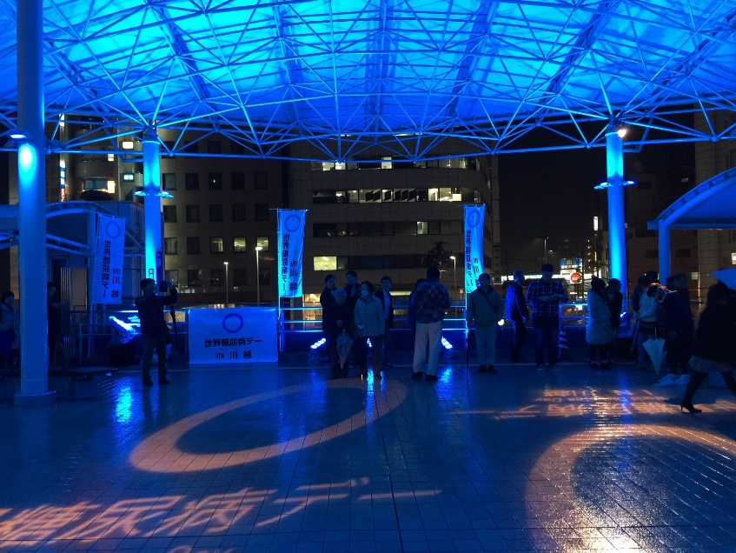
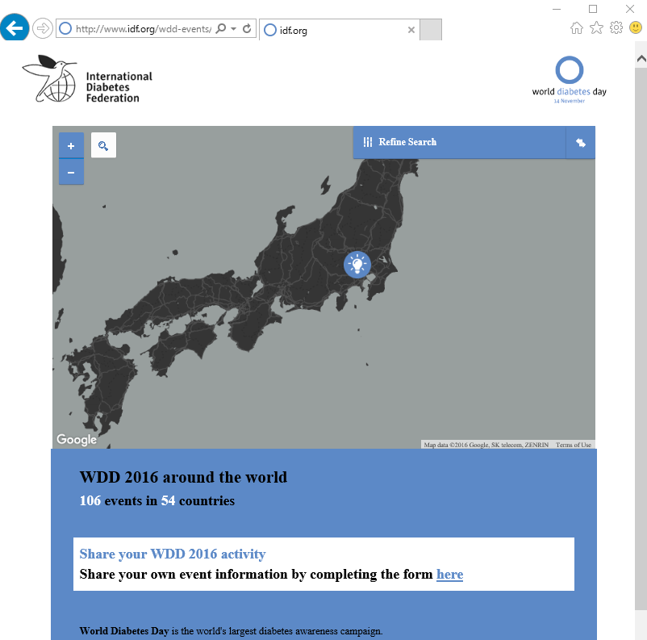
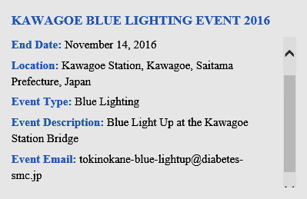
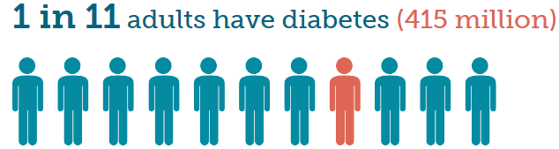
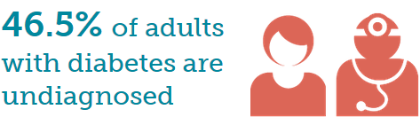
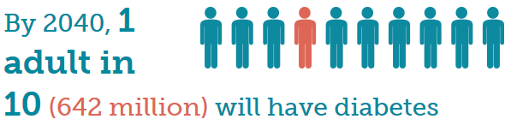
2015年11月14日
http://www.diabetesatlas.org/key-messages.html
http://tokinokane-blue-lightup.diabetes-smc.jp/forpc.html

